Slide 1
Singleton Pattern
Using DCL

Slide 2
Key Features
Intent: Have only one of an object, ensure that all entities are using the same instance of this object, without passing a reference
Problem: Several different client objects need to refer to the same thing, and you want to ensure that you do not have more than one of them

Slide 3
Key Features
Solution: Guarantee one instance
Participants and collaborators: Clients create an instance of the Singleton solely through the getInstance method
Consequences: Clients need not concern themselves whether an instance of the Singleton exists. This can be controlled from within the Singleton

Slide 4
Implementation
Add a private static member of the class that refers to the desired object (initially it is null)
Add a public static method that instantiates this class if this member is null (and sets this member’s value) and then returns the value of this member.
Set the constructor’s status to protected or private so that no one can directly instantiate this class and bypass the static constructor mechanism

Slide 5
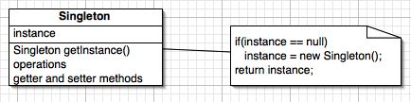
Generic Structure

Slide 6
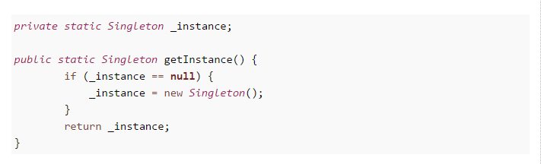
Implementation

Slide 7
Problem
Might lead to multiple instances of the Singleton object when getInstance() called at the same time by multiple parallel threads
Thereby we lose the purpose of Singleton

Slide 8
Problem
When two calls to getInstace() are made by two threads at the same time:
First thread checks if instance exists. It does not, so it will create the first instance
Before it is done, second thread also checks if instance exists, it does not, so it will create the second instance

Slide 9
Problem
If the class is stateless, then not a problem
Otherwise, changes in one object will not be reflected in all the other objects
If there is a connection, there will be two connections
If there is a counter, there will be two counters
A solution would be to make the entire method getInstance() synchronized

Slide 10
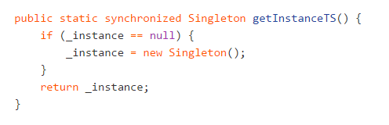

Slide 11
synchronized method
Though it’s a thread-safe and solves issue of multiple instance, it's not very efficient.
All the threads will have to wait for the check on whether the object already exists
You need to bear cost of synchronization every time you call this method, while synchronization is only needed on first class, when Singleton instance is created.

Slide 12
Double Checked Locking (DCL)
Only applies to multithreaded applications
Optimizes unnecessary locking
Synchronization happens utmost one time, so not a bottleneck

Slide 13
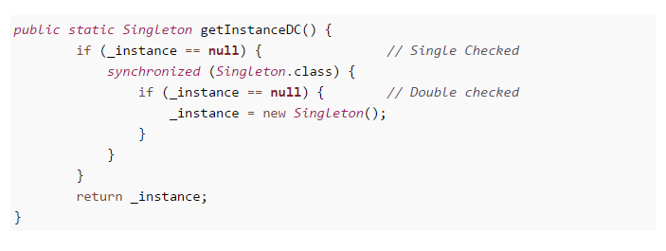
DCL
Feature: Unnecessary locking is avoided by adding another test before creating the object

Slide 14
DCL
On surface this method looks perfect, as you only need to pay price for synchronized block one time, but it still broken, until you make _instance variable volatile.
Without volatile modifier it's possible for another thread in Java to see half initialized state of _instance variable, but with volatile variable guaranteeing happens-before relationship, all the write will happen on volatile _instance before any read of _instance variable.

Slide 15
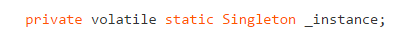
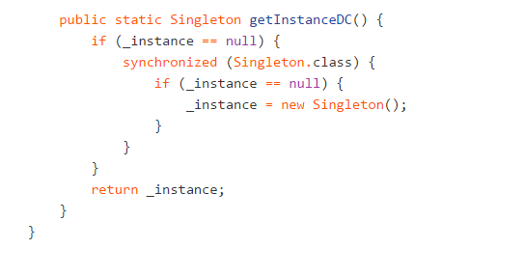
DCL Implementation

